Slide 1



S304 - How Kaufland Transitioned to Experience Manager in the Cloud
Santosh Mishra, Senior Technical Architect, Adobe Consulting Services
Benjamin Gantikow, Senior Professional IT, Web Solutions, Schwarz IT KG

Slide 2
Key Takeaways
1
How to properly manage a successful Cloud Service migration
2
How your project team composition and migration strategy could look like
3
Which services and tools will help you to succeed

Slide 3


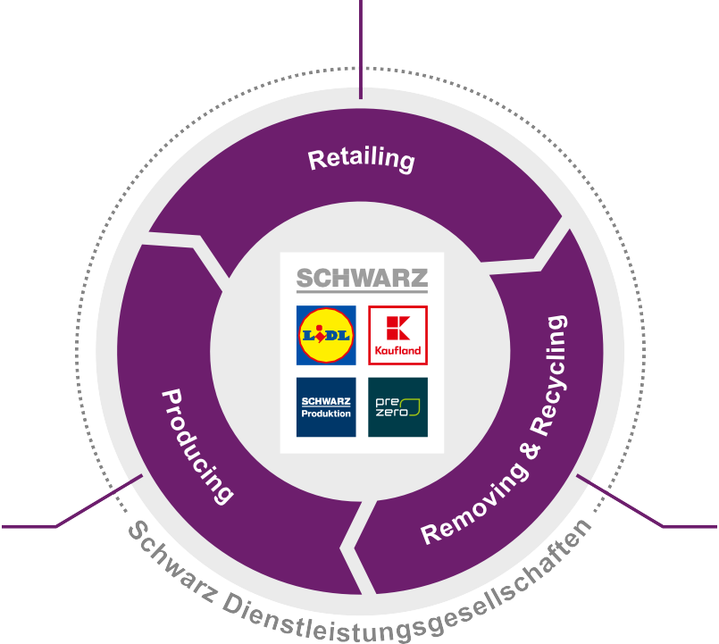




Schwarz Group
Leading food retailer in Europe,
4th biggest in the world, based on revenue
Lidl: approx. 11,550 stores in 29 countries
Kaufland: approx. 1,350 stores in 8 countries
PreZero: growing waste and recycling management branch
Schwarz Produktion: producer for beverages, chocolate, dried fruits, backed goods and ice cream

Slide 4







4,000
IT experts
65,000
supervised IT workstations
20,000
data center servers
28 Petabyte
data center storage
Provides modern cloud
infrastructure to DACH SMEs

Slide 5



Mission critical topics
Performance
Connectivity
Content Transfer
Migration project team
Migration strategy

Slide 6


Cloud Service helped us to reduce performance impacts with auto- scaling.
Issue
Performance matters. Our On-premise architecture perfectly satisfied our needs, but we wanted to eliminate remaining risks using an auto-scaling infrastructure.
Solution
AEMaaCS not only helped us with that, but also reduced the costs we had for our On-premise setup. We gained leverage by utilizing Fastly CDN and a finetuned Dispatcher cache configuration.
AEMaaCS auto-scaling at work

Slide 7

Cloud Service helped us to reduce performance impacts with auto-scaling.
Advice
Performance optimization is a steady process, so keep your eye on performance and caching reports. Use the data AEMaaCS provides to identify issues and find long-lasting solutions.
47
Performance
69
Accessibility
92
SEO

Slide 8




We kept integration intact by using the VPN capabilities of Cloud Service.
Issue
On On-premise, we had to tackle with connectivity issues between AEM Author and external software like Adobe Campaign, Adobe Analytics, etc. But if we would just move to the cloud, we would have lost connection to many internal services, which provide data we show on our websites.
Adobe Target
Adobe Experience Manager
Adobe Analytics
Adobe Campaign

Slide 9




We kept integration intact by using the VPN capabilities of Cloud Service.
Solution
Since we moved to the cloud, it was a lot easier to integrate external services in AEM.
Together with our and Adobe’s network specialists, we set up the very first VPN connection between Cloud Service and a company network.
With that, we were still able to access all our internal data sources.
Advice
Make use of integrations Adobe offers to monitor AEMaaCS and its service connections, e.g., using New Relic One or your own Splunk.
Adobe Analytics
Adobe Target
Adobe Experience Manager
Adobe Campaign

Slide 10
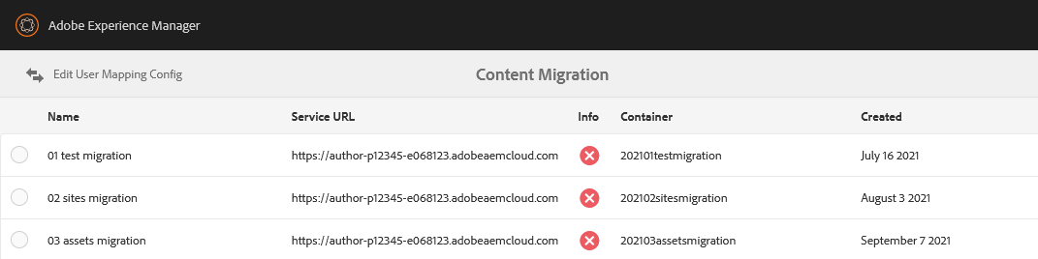
We reverse-engineered Cloud Transfer Tool to solve connectivity issues.
Issue
The versions of Cloud Transfer Tool we had used for transferring our On-prem content to the cloud has not offered proxy settings. Since we were sitting in a secured network, this was a real blocker.

Slide 11


We reverse-engineered Cloud Transfer Tool to solve connectivity issues.
Solution
We reverse-engineered the tool and its behavior to run it with proxy parameters on the command line. Adobe was there to help and verified the workaround we found. According to them, proxy settings are now a feature of the tool.
Advice
Since a cloud migration is worthless without your content, start to make your first test transfers as early as possible. Once you finished your tests or something broke, wipe the target cloud environment to start again.

Slide 12






Putting a well-established team onto the migration project made us faster.
Issue
Sourcing out the migration, just waiting for the results will end up in chaos and not identifiable risks. If you put together a new team, you will waste time in team staffing and organization.
?
?
?
?

Slide 13


Putting a well-established team onto the migration project made us faster.
Solution
By using the same Kaufland and Schwarz IT team that already worked with AEM On- premise, we were able to start right away. Adobe Consulting Services helped us to make our code cloud-compatible.
Advice
Be part of the migration. You will learn about things you wouldn’t do during your everyday business. Keep on working with the ticket and wiki tools you have used for AEM On-premise and invite Adobe to it.

Slide 14






Because we planned it properly, we identified and fixed issues early.
Issue
Due to many international websites we manage with AEM, it was clear we had to work out a migration strategy that satisfied our internal processes like two-week sprints, development, testing and releasing cycles.
On-premise
(detailed level)
Sprint 2 weeks
Testing 2 weeks
Requirements Engineering
Release
Prod Deployment
Cloud migration (high level)
Go-Live Phase 1
Go-Live Phase 2
Go-Live Phase 3

Slide 15
Because we planned it properly, we identified and fixed issues early.
Solution
We listened to Adobe Consulting Services, but always reflected and applied our strategy on it. By splitting the migration into three faces, from static to complex websites, we learned and got better with each phase.
Advice
First finish your one-to-one migration before you utilize new features of AEMaaCS. Do test migrations to proof your plans and to see how it works, which pitfalls might happen, etc.
Phase 1 Minor websites
Static microsites, less attention, less traffic.
Phase 2 Major websites
Medium-sized websites like our Career and Corporate Websites.
Phase 3 Most critical websites
Business-critical websites with a lot of traffic, service connections and dependencies.

Slide 16
Key Takeaways
1
How to properly manage a successful Cloud service migration
2
How the project team composition and migration strategy could look like
3
Which services and tools will help you to succeed

Slide 17















Anatomy of a cloud migration
Readiness
Planning & Setup
Implementation
Go-live
Optimization
Assessment of AEM best practices being followed
AEM as a Cloud Service provisioning
Get code and project structure ready for AEMaaCS
Code and content freeze periods
Continue to modernize code
•
High-level migration complexity assessment
•
Detailed migration assessment
Performance and security tests
Optimize content
Move existing content and ACLs to Cloud Service
•
Project plan creation and resource planning
Cut-over
Enable IMS SSO for Author

Slide 18

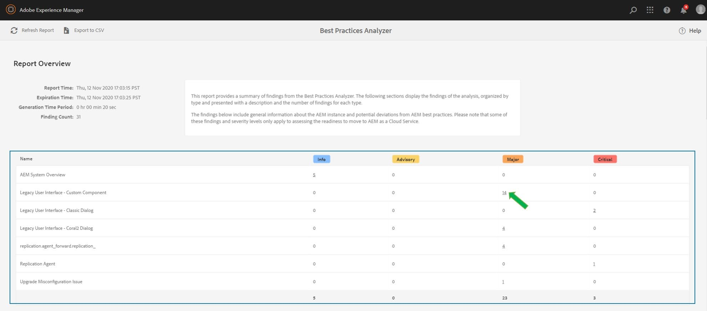

Start your readiness self-assessment with the Best Practices Analyzer
Always use the latest version of BPA
Once installed, available under Tools
> Operations > Best Practices Analyzer
Only available to admin or users in the administrators group
6.1 or above
Recommended to run on a production clone
4 importance levels for violations
INFO
ADVISORY
MAJOR
CRITICAL
https://adobe.ly/3qvrWQ0

Slide 19

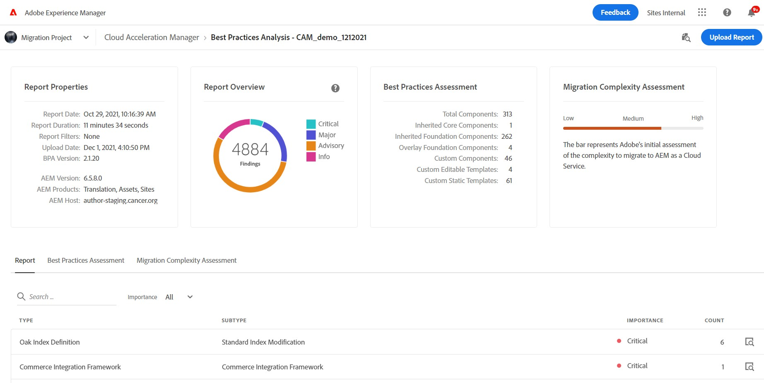

Review your readiness self-assessment in Cloud Acceleration Manager
Benefits of Cloud Acceleration Manager (CAM)
Plan better and smarter
Content Assessment
Code Assessment
Streamline the migration with end-to-end guidance
Guidelines and best practices
throughout the journey
Optimize migration effort
Learn about automation tools to minimize migration time
https://adobe.ly/3ntrm31

Slide 20





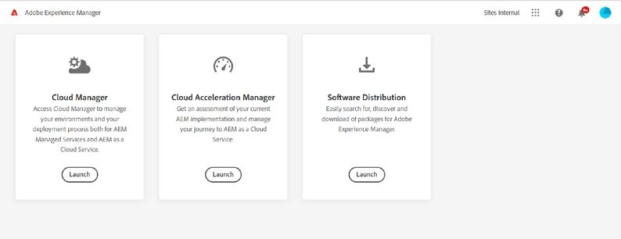
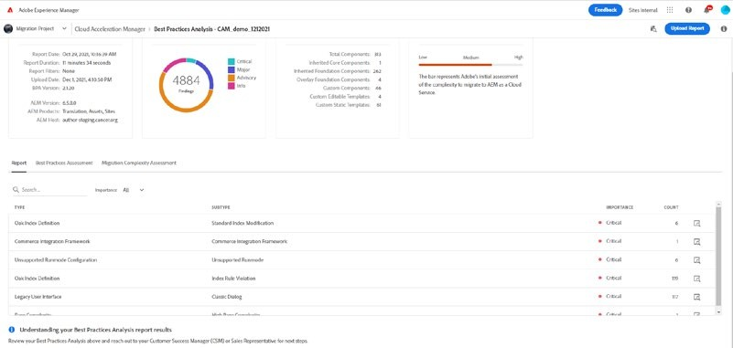






3 Simple Steps to Self-assess Migration Readiness
Readiness
Assessment of AEM best practices being followed
High-level migration complexity assessment
Step 1
Step 2
Step 3
Install & execute Best Practices Analyzer (BPA) and download BPA report

Slide 21












Planning & Setup
Create a Migration Plan (Content & Code)
Create Environments and Setup Cloud Manager
Strategize DevOps Culture Change

Slide 22





Creating a Content Migration Plan
Pre-requisites:
Content Assessment in CAM
Initial Migration
Partial content transfer: Prod Clone -> CS Dev / Stage
Identify and resolve issues
Record details for initial content transfer
Determine Top up or Full migration before go live
Final content transfer
Full content transfer: Prod -> CS Prod
Record details for top-up/final content transfer
UAT
Performance Tests
Proof of Migration
Top up / Final Migration
Content Transfer Tracker
Content Transfer Plan | Migration Set Name | Set Size | Source | Destination | User Mapping (Y/N) | Extraction Time | Ingestion Time | Details
Proof of migration | Set 1 | XX MB | Prod Clone | CS Dev | Y
Initial migration | Set 2
 | Set 3

Slide 23

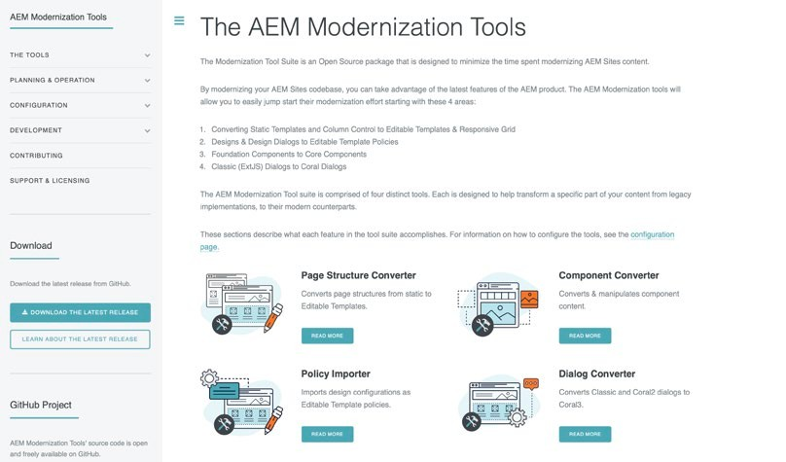
Creating a Code Refactoring Plan
Pre-requisites:
Code Assessment in CAM
Understand Code Refactoring Tools
Simplify by categorizing critical findings:
Front End
Key patterns: LUI, CCOM
Back End
Key patterns: DG, CAV, REP
Configurations
Key patterns: ODI, WRK, URC
Dispatcher
Unified Experience Plugin
AEM Modernization Tool Suite
https://adobe.ly/3tBJuJp
https://adobe.ly/3nt84Lk
Repository Modernizer
Index Converter
Dispatcher Converter
AEM Assets Workflow Migration
Adobe’s code refactoring tools can help reduce effort and accelerate migration

Slide 24








Start content, code, and operational workstreams in parallel to ensure a smooth migration
Content Migration
Code Migration
Operational
QA Strategy Security Review
Content Transfer Tool
Install and Configure
Validate connectivity, available diskspace, cpu etc.
Initial Migration
Create Migration Sets
Extract, Ingest and validate
CS Supported Project Structure
Repository Modernizer
Oak Index Convertor
AEM Workflow Migration
Configure Cloud Manager Pipelines
Env. Specific Pipelines
Front End Pipeline
Quality Pipeli
UAT Plan
Performance Testing
Top Up Migrations
Incremental
Final Migration before Go Live
AZCopy Pre Copy
Install AZCopy
Configure AzCopy
Refactor Dispatcher Configurations
Dispatcher Convertor
Validator and Testing
Iterative Development
Sprint Cycles

Slide 25





Go-live readiness before Launch
Content Transfer
Initial Completed
Top up Planned
01
Code Migration
Deployments Working
QA Testing Complete
02
UAT
03
Execution Complete
Defect Triage and known issues identified
Performance Testing
Execution Complete
Review outputs & Optimizations identified

Slide 26

Countdown until Launch
Launch Day
T – 1 Days
DNS cutover
Post switch testing
Notify CSME that site has been launched
Monitor logs
T – 2 Days
Go/No-go decision
T – 7 Days
Notify assigned CSME of launch
Production system readiness for launch
Validate rollback plan
Code freeze
Setup monitoring
Setup DNS and SSL certificates

Slide 27


Key Takeaways
3
Which services and tools will help you to succeed
How to properly manage a successful Cloud service migration
How the project team composition and migration strategy could look like
TW109 - Tips and Tricks for Migrating to Experience Manager in the Cloud - to learn more about Cloud Migration Tools
Makes sure to view the following:

Slide 28














Helpful Resources
AEM as a Cloud Service documentation
Moving to AEM as a Cloud Service
AEM as a Cloud Service Release Notes
AEM Migration Tools Release Notes
https://adobe.ly/320CWex
https://adobe.ly/3qtmcWR
https://adobe.ly/3nsZJHj
https://adobe.ly/3Kceo3o

Slide 29


Q & A

